Slide 1
NN Project
Ori Daniel & Or Sasson

Slide 2
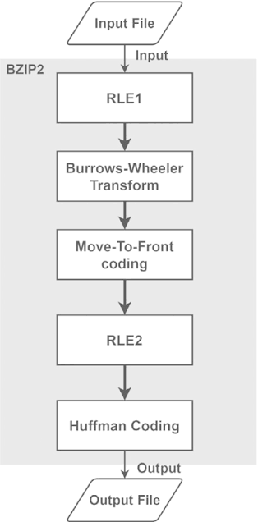
Benchmark #1 - Pyflate
What is Pyflate?
Implementation Overview
Initial Analysis
Software Optimizations
Performance Comparison

Slide 3
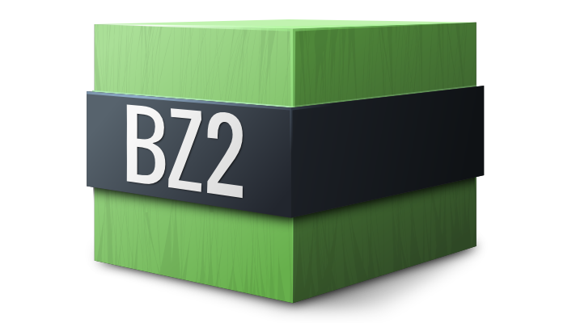
What is Pyflate Benchmark?
Pyflate is a benchmark that tests the speed of the Bzip2 compression algorithm
It is implemented in pure-python, with no calls to fast C libraries.
The test consists of decompressing a file using a python implementation of bzip2 decompression.
It tests how fast a Python version can execute math and logic operations for decompression without external C-based shortcuts.

Slide 4


Bzip2
Bzip2 is a file format and a file compression algorithm.
It utilizes the Burrows-Wheeler algorithm, invented by David Wheeler and published by Michael Burrows in 1994.
It is a 5 stage algorithm, which runs on small chunks of a file in parallel.

Slide 5
Bzip2
Run-Length Encoding - pass #1: Replace sequence of 4-255 identical consecutive bytes with a single character and count. Prevents repetative data from degrading the BWT sorting phase.
Burrows-Wheeler Transform (BWT): Reorders chunks of the file to group similar characters together.
Move-to-Front (MTF) Encoding: turns identical characters to 0's, which keeps logical meaning of repeated character, but helps Huffman Coding.
Run-Length Encoding (RLE, Pass 2): targets the large amount of 0's generated by the last stage.
Huffman Coding: encodes characters by their frequency. High frequency characters receive low bitcount sequences.

Slide 6
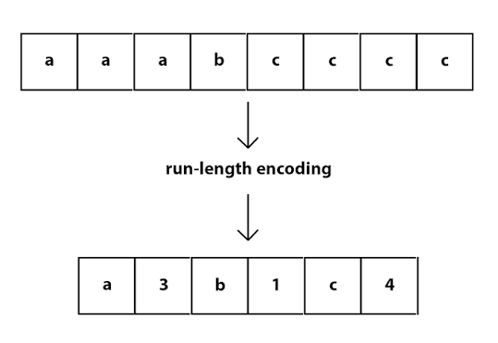
Run-Length Encoding
Run-Length Encoding compresses long repeating strings of the same character to a compressed format. It outputs the first 4 instances of a character and then symbolizes the rest of it’s appearances with a number:
aaaaaaaaaa -> aaaa6

Slide 7
Burrows-Wheeler Transform (BWT)
This is the core of the algorithm.
The idea is to rearrange a block of data into runs of identical characters without actually compressing it or losing any information.
The resulting column is the compressed version of the string, which will be used for restructuring during uncompression.
We will demonstrate the algorithm with a worked example.

Slide 8
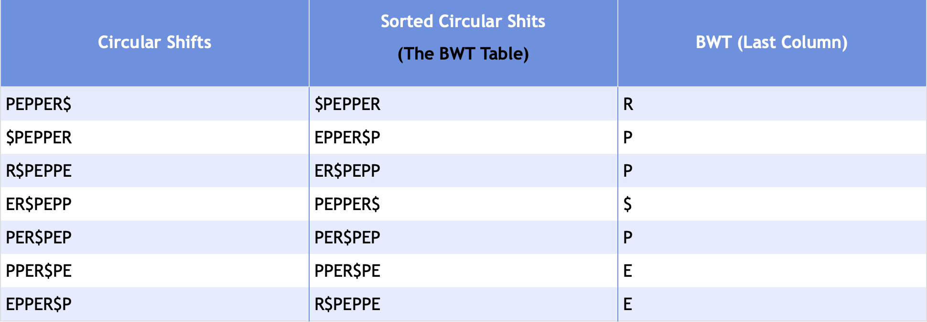
Burrows-Wheeler Transform (BWT)
We will show the algorithm with the example string: PEPPER
For an input string of length N -
Add $ to the end of the string: PEPPER$
Generate all N cyclic shifts:
Sort the circular shifts:
Take the last column; That is
the BWT string.

Slide 9
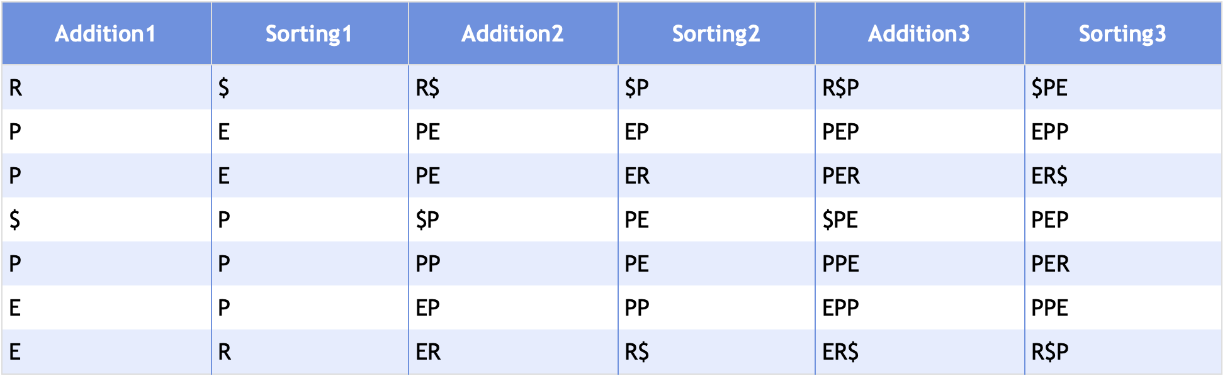
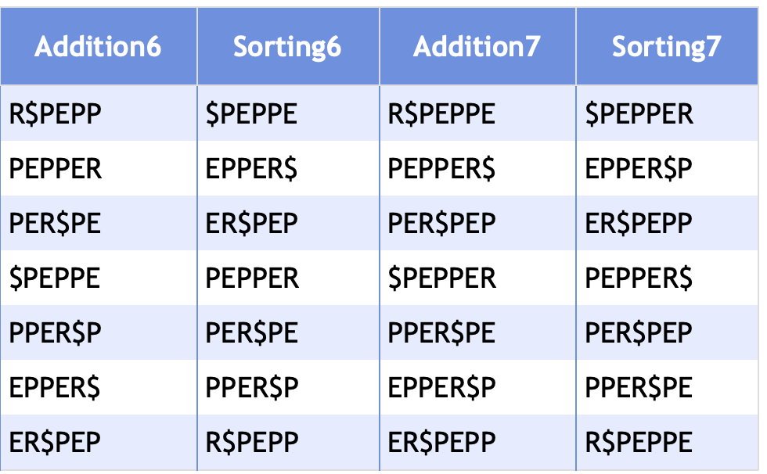

Burrows-Wheeler Transform (BWT)
We will show how to decode the word from the BWT string: RPP$PEE:
Run N times:
  Add the transformed string to an empty table - Addition1
  Sort the table - Sorting1
  Combine the two columns – Addition2
The decoded string is the one with $ at the end: PEPPER$

Slide 10
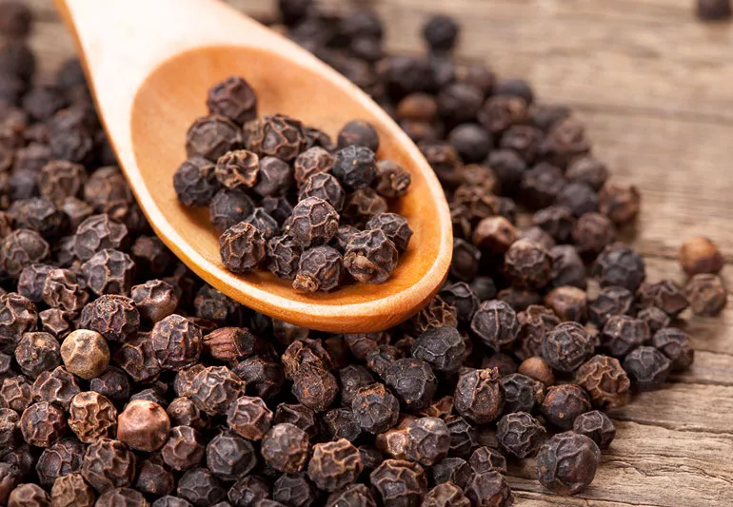
Burrows-Wheeler Transform (BWT)
From “PEPPER” we got RPP$PEE.
Why does this help us?
Sorted data is easily compressible.
The Burrows-Wheeler Transform aims to exploit the property of local context of real world data. In real languages and structured data, specific characters precede certain sequences, such as the letter ‘t’ before ‘he’ in the word ‘the’.

Slide 11
Move-To-Front & Huffman Encoding
The BWT gave us consecutive letters in the string, but now we need to actually compress them.
First we will explain Huffman Encoding:
  The algorithm takes a string with a fixed amount of characters, and compresses it based on the frequency of those characters.
  The Algorithm uses a tree and greedy search assumption to give each character a readable encoding - (can be distinguished when in a contiguous string).
  For example: in the string “PPPPPPPPPABCD”, there are 5 characters total. It would be most efficient to give ‘P’ a more conservative encoding – like “0”.
  An example of encodings would be:
  P: 0
  A: 100
  B: 101
  C: 110
  D: 111
  And the resulting encode would be: 00000000000100101110111, or 0x000977

Slide 12
Move-To-Front & Huffman Encoding
Move-to-front simply takes consecutive letters, and turns all but the first appearance to ‘0’. A 0 indicates a “duplicate the letter before me” operation.
Considering the other steps, this makes sense to use – we will get a high frequency of consecutive letters following the BWT algorithm. After a simple manipulation, a “consecutive letter” becomes it’s own character, which is exactly what the following Huffman Encoding wants to exploit.
The RLE in the middle is used to compress all the 0’s together, for maximum compression.

Slide 13

Benchmark #1 - Pyflate
What is Pyflate?
Implementation Overview
Initial Analysis
Software Optimizations
Performance Comparison

Slide 14
Pyflate – Baseline results
We ran: pyperformance run --python /usr/bin/python3.10 --bench pyflate
60 decompressions of a 67.5 KB bzip2 archive (399 KB decompressed), across 20 different processes. These were the results:
Timing – 60 samples
Hardware counters — per single decompression
Metric | Value
Mean | 1.124 s ± 0.018 s
Min / Max | 1.108 s / 1.229 s
Samples | 60 (20 processes × 3 values)
Metric | Value | Rate
Instructions
Cycles |  | IPC: 2.63
Branches |  | ~20% of instructions
Branch misses |  | 0.34%
Cache references
Cache misses |  | 7.09%

Slide 15
Pyflate – Baseline results
We used py-spy to profile the Cpython benchmark.
To get the flamegraph we ran: py-spy record --rate 999 --output results/baseline/flamegraph.svg
Hotspot metrics with py-spy
Metric | Self time
move_to_front | 15.6%
Find_next_symbol | 14.2%
readbits/snoopbits/_mask/_read | 25%
bwt_transform + bwt_reverse | 12%

Slide 16
Benchmark #1 - Pyflate
What is Pyflate?
Implementation Overview
Initial Analysis
Software Optimizations
Performance Comparison

Slide 17
Pyflate – Initial Analysis
Looking at the results, one metric stands above the rest – pure instruction count.
We see that this is not an issue of branch or cache misses, but simply of running too many lines of code.
This is mainly a result of being a pure python library – no efficient C call libraries.
We can see this clearly by comparing pyflate to a bzip program written in C:
 | Time per decompression | Instructions per output byte
C bzip2 (system) | 18 ms | -
Python pyflate | 1.124 s | ~17,900

Slide 18
Pyflate – Initial Analysis
Let’s analyze the flamegraph to understand what’s providing the bottleneck.
As we can see, the decode_huffman_block is running for essentially all of the program.
The breakdown:
 | % of runtime
Find_next_symbol | 47.22%
Move_to_front | 15.39%
Bwt_reverse | 13.50%
Own lines | 21.58%

Slide 19
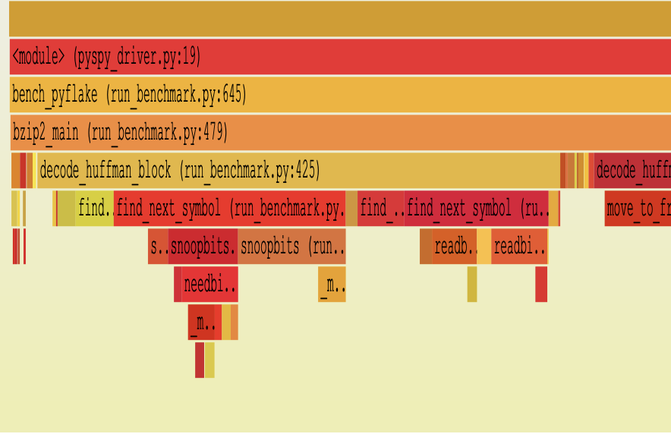
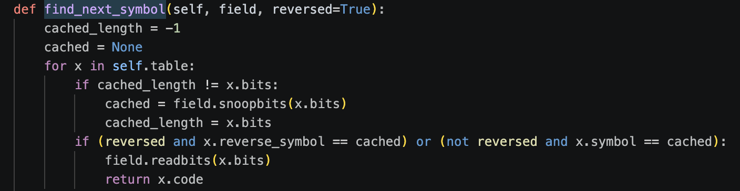
Pyflate – Initial Analysis
Let’s analyze find_next_symbol:
looking at the flame graph and hotspots, this is the largest section of our code.
What find_next_symbol does:
Decodes one Huffman symbol from the bitstream:
This is called for every symbol, costing the program ~22,800 instructions per symbol.

Slide 20
Pyflate – Initial Analysis
What’s going on here?
The decoder’s only job: map the next bits of the stream (a codeword) to the symbol they stand for – the letter “A”, or “%”.
For every symbol it walks the table from the front:
  peek x.bits bits of the stream (re-peeking only when the code length changes),
  compare them against that entry’s codeword x.symbol,
  on a match, consume those bits and return x.code.
The code executes a linear search for the symbol, from scratch, for every symbol in the file.
Decoding one symbol: the scan
entry 1
2 bits
peek 11
= 00 ?
no
entry 2
2 bits
reuse 11
= 01 ?
no
entry 3
2 bits
reuse 11
= 10 ?
no
entry 4
3 bits
peek 110
= 110 ?
MATCH
4 comparisons + 2 peeks – for one symbol
The table holds 147 entries; a symbol walks 6.0 of them on average, and up to all 147.
010 -> “A”

Slide 21
Pyflate – Initial Analysis
The problem?
Linear search: 147 entries per table.
No memory between calls: nothing is cached, so each of the ~148,000 symbols restarts the scan from the front.
Every peek is a call chain: snoopbits() → needbits() + _mask(), then readbits – about 9 Python calls per symbol.
The structure is ignored. We will show in our optimization that bzip2 structures the data in an efficient way, but the current implementation does not utilize this.
What one symbol costs
find_next_symbol
46.4%
of total runtime
snoopbits() × 2.3
~22,500
instructions / symbol
needbits()
_mask()
~8,500
cycles / symbol
readbits() → 2 more
~890k
loop iterations / decompression
≈ 9 Python calls
Pure Python: the cost is the number of bytecodes and calls, not the data touched – IPC 2.64, branch misses 0.35%.
010 -> “A”

Slide 22
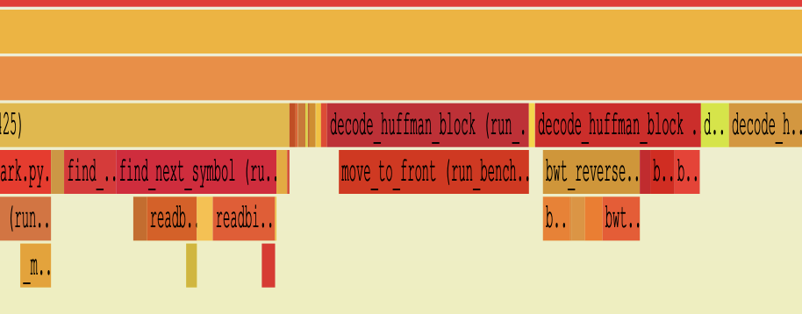
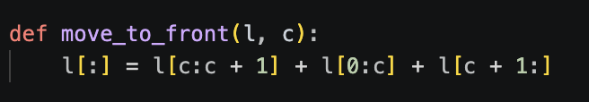
Pyflate – Initial Analysis
Let’s analyze the move_to_front section.
looking at the flame graph and hotspots, we find a plateau on move_to_front stage.
Looking at move_to_front’s code – 15.6% of the run:
This method is called on average 90k times per decomposition, with an average list length of 150.
The problem is that the implementation ignores that locality completely and rebuilds the entire 150-element list every time.

Slide 23
Benchmark #1 - Pyflate
What is Pyflate?
Implementation Overview
Initial Analysis
Software Optimizations
Performance Comparison

Slide 24
Pyflate – Software Optimizations
First we will go over the improvement of find_next_symbol.
Since bzip2 is a file format, it can control both the encode and decode stage.
This allows us to exploit something called Canonical Huffman.
Canonical Huffman: the codeword is determined by the code lengths alone, through a fixed assignment rule. So only the lengths have to be stored in the file; the decoder rebuilds identical codes.
Canonical huffman rules say:
Sort the symbols by their assigned length, (shortest first) and secondly by lexicographic order.
Initialize the first symbol to be a code of all zeros.
Calculate subsequent codes using this logic:
  If curr_length == prev_length: new_code = prev_code + 1
  If curr_length > prev_length: new_code = (prev_code + 1) << (curr_length - prev_length) ( add 1 and bit shift by difference)

Slide 25
Pyflate – Software Optimizations
The improved algorithm:
Instead of looping through all possible values – we search one length at a time.
We hold length bits as the “current symbol”, and compare that to the largest code of that length.
Remember – we sorted lexicographically, so if it’s larger, that means the length is wrong.
Once we are in the “right length” – we can use another trait of Canonical Huffman.
If our code is the k-th element of a certain length, its bit value will also be exactly k above the base of that length.
We create the limit and base arrays at the start, and work with them throughout the whole decode.

Slide 26
Pyflate – Software Optimizations
Another win is removing expensive Python calls.
Original: each loop calls snoopbits() → needbits() + _mask(), then readbits() – about 9 calls per symbol.
New: the same logic is written inline in the loop, so the decode path makes no calls at all.
  snoopbits / readbits / _mask: 24.18% → 0.63% of runtime.
Measured Improvement
  6.0 table entries → 2.3 length steps per symbol.
  48.1% of symbols decode on the first peek.
  Worst case 14 steps (code lengths), not 147 entries.
  find_next_symbol: 46.4% → 24.1% of runtime.
  ~22,500 → ~12,400 instructions per decoded symbol.
  This change on its own: 22.8% faster.
Per decoded symbol: call chain
ORIGINAL
OPTIMIZED
find_next_symbol
find_next_symbol
snoopbits() × 2.3
inline arithmetic
(bitfield >> (bits − n)) & ((1 << n) − 1)
needbits()
_mask()
readbits() → 2 more
≈ 9 Python calls
0 calls
Length steps per symbol (new decoder)
48.1%
23.7%
10.4%
5.7%
5%
3.5%
3.6%
1
2
3
4
5
6
7+
average 2.3 steps • before: 6.0 table entries scanned

Slide 27
Pyflate – Software Optimizations
Optimization 2: move_to_front
Called about 90,000 times per decompression, on a list of ~150 entries.
Original uses Python slice, which rebuilds the whole list every call.
three slices, concatenated into a fourth list in total four O(n) passes and four allocations.
New: l.insert(0, l.pop(c). Both are C-level list methods that shift elements inside the existing array and allocate nothing.
Measured Improvement
  move_to_front: 16.9% → 2.2% of runtime.
  This change on its own: 15.7% faster, 11.5% fewer
What happens on one call
ORIGINAL
OPTIMIZED
l[:] = l[c:c+1] + l[0:c] + l[c+1:]
if c: l.insert(0, l.pop(c))
build 3 slices
pop(c): shift left (memmove)
concatenate → 4th list
insert(0): shift right by one
copy back over l[:]
c == 0 → returns immediately
4 allocations per call
0 allocations per call
move_to_front: share of runtime (py-spy)
original
16.9%
optimized
2.2%
~90k calls per decompression × ~150 entries rebuilt each time

Slide 28
Benchmark #1 - Pyflate
What is Pyflate?
Implementation Overview
Initial Analysis
Software Optimizations
Performance Comparison

Slide 29
Pyflate – Performance Comparison
Both versions measured in one scripted run, same VM, same venv (script_pyflate.sh).
pyperformance, 60 samples each:
  1.141 s → 0.714 s = 1.60x faster
  Significant: t = 48.58.
  Median 1.125 s → 0.712 s (1.58x).
The diagnosis held: instructions fell 33.6% and cycles followed (−35.2%), while IPC barely moved the machine was never stalling, it was just running fewer instructions.
Wall clock per decompression
original
1.141 s
optimized
0.714 s
1.60x faster • 427 ms saved per decompression
Hardware counters (perf stat)
counter | baseline | optimized | change
cycles | 13.60 B | 8.82 B | −35.2%
instructions | 35.90 B | 23.82 B | −33.6%
branch-misses | 24.9 M | 14.2 M | −42.9%
L1-dcache-load-misses | 278 M | 70 M | −74.7%
IPC | 2.64 | 2.70 | +2.3%

Slide 30
Pyflate – Performance Comparison
Where the time went (py-spy, share of the original's runtime)
  find_next_symbol: 46.4% → 24.1%
  move_to_front: 16.9% → 2.2%
  snoopbits / readbits / _mask: 24.2% → 0.6%
  bwt_reverse and bwt_transform are untouched (13.4% → 13.6%, 8.0% → 7.9%) – they are what a third optimization would target.
Performance Impact – best-of-12 per variant
original
1.126 s
move_to_front only
0.949 s −15.7%
find_next_symbol only
0.869 s −22.8%
both
0.710 s −37.0%
instructions: 21.5 B → 19.0 B / 17.0 B → 14.3 B
Per decoded symbol
 | baseline | optimized
instructions in find_next_symbol | ~22,500 | ~12,400
cycles in find_next_symbol | ~8,500 | ~4,600
steps to decode one symbol | 6.0 entries | 2.3 lengths

Slide 31
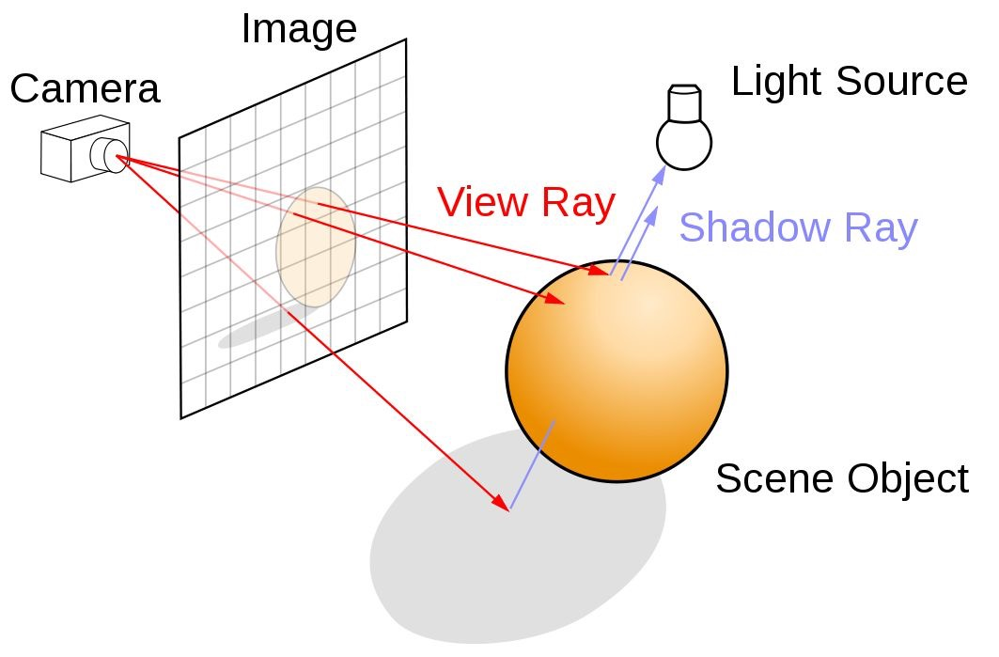
Benchmark #2 - Raytrace
What is ray tracing?
Implementation Overview
Initial Analysis
Software Optimizations
Performance Comparison
Hardware Accelerator Proposal

Slide 32
What is Raytrace Benchmark?
This is a benchmark to test how fast an image is rendered.
Implemented in pure python, excluding one array library usage, to handle an allocation of an array for the image’s pixels before storing them in a file.
It creates 7 spheres and a flat plain, render this scene, and store it in a pixel map file.
But how does ray-tracing actually work?

Slide 33
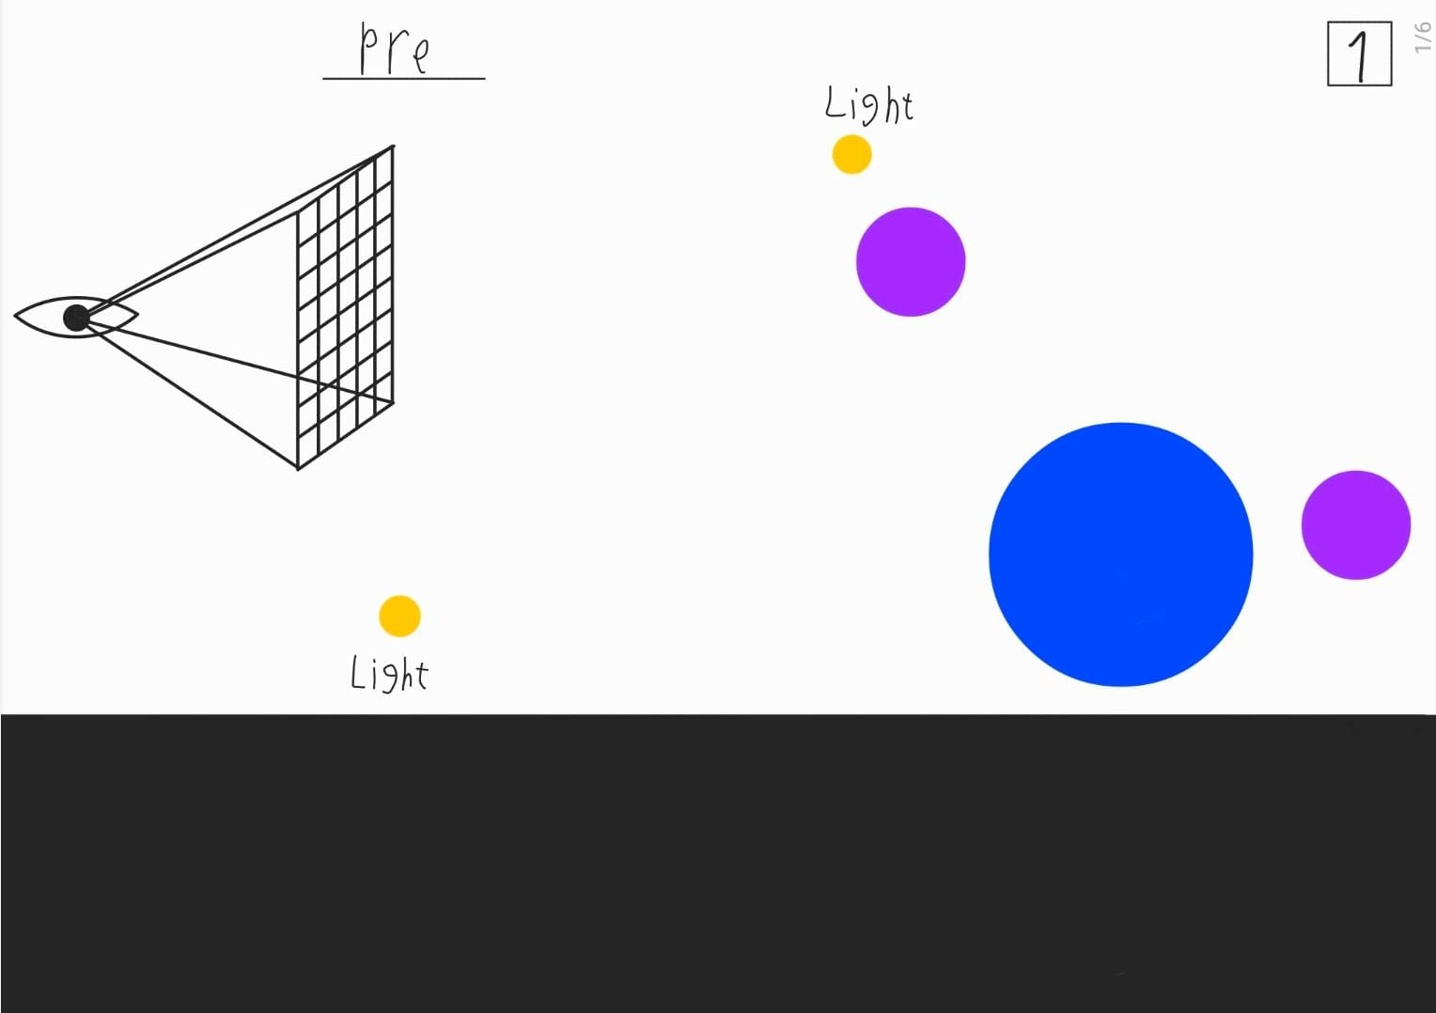

Slide 34
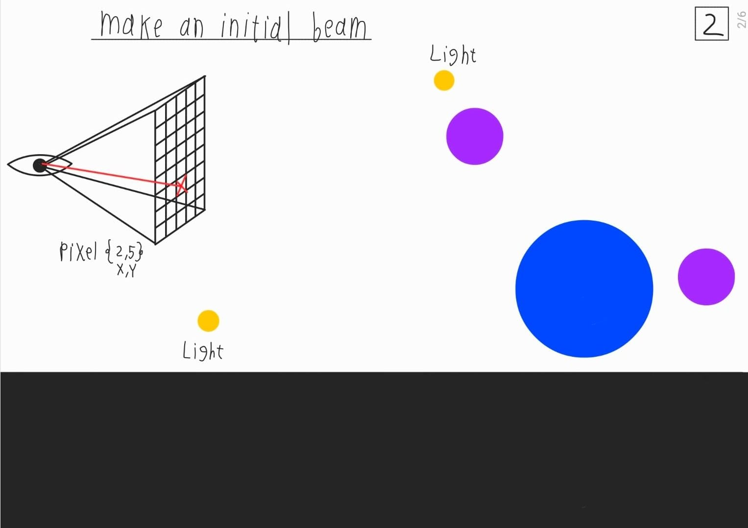

Slide 35
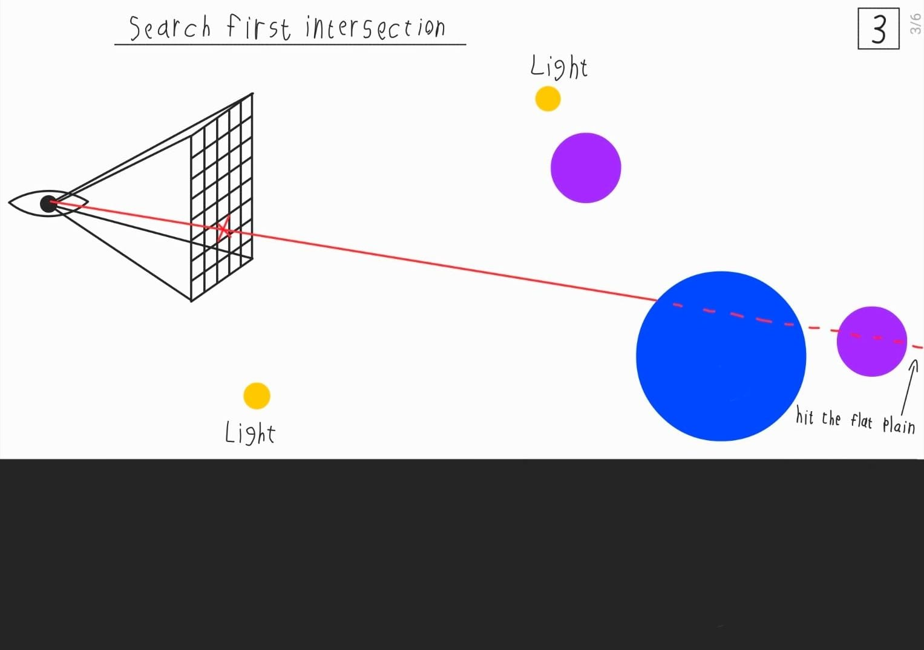

Slide 36


Slide 37
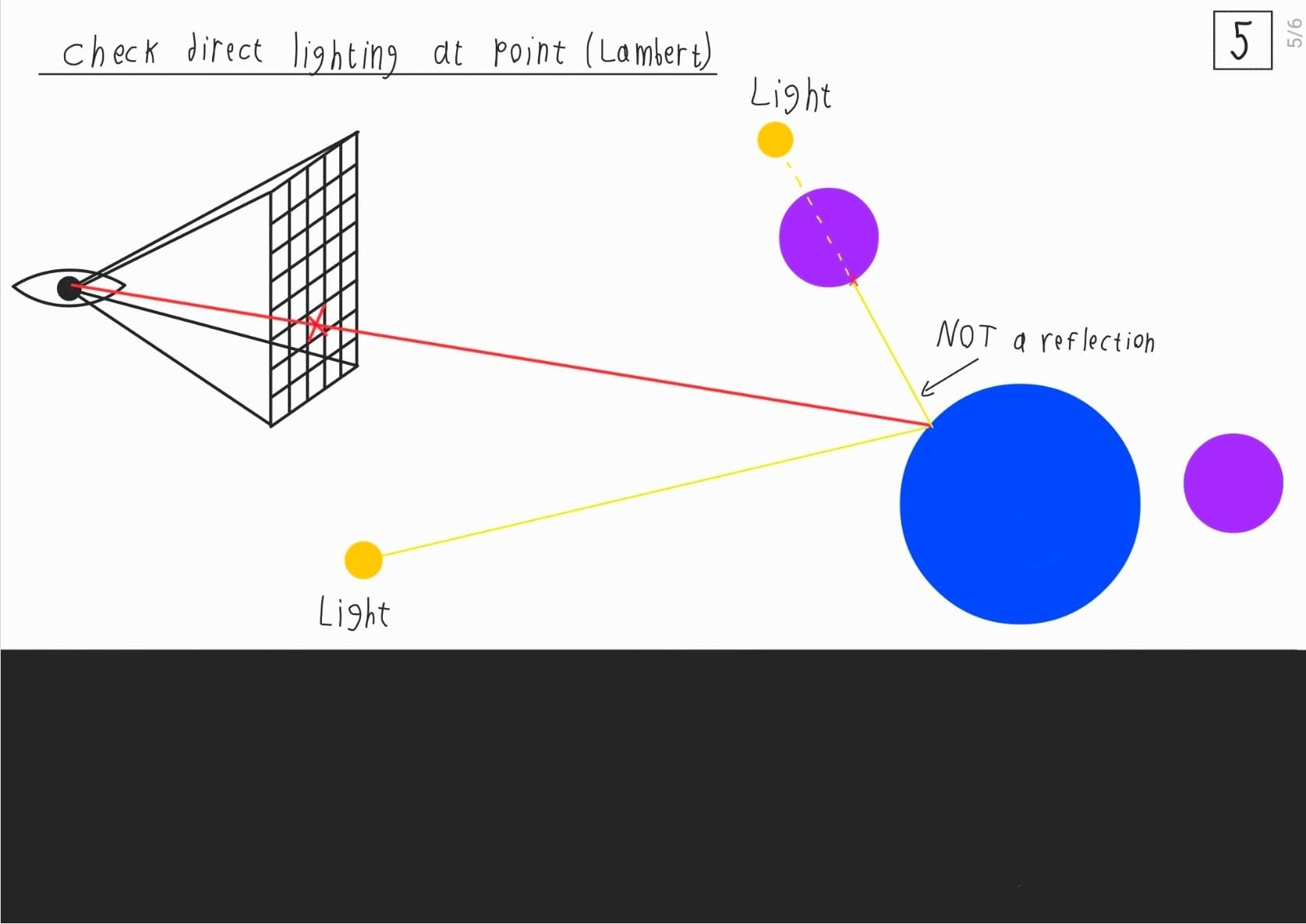

Slide 38
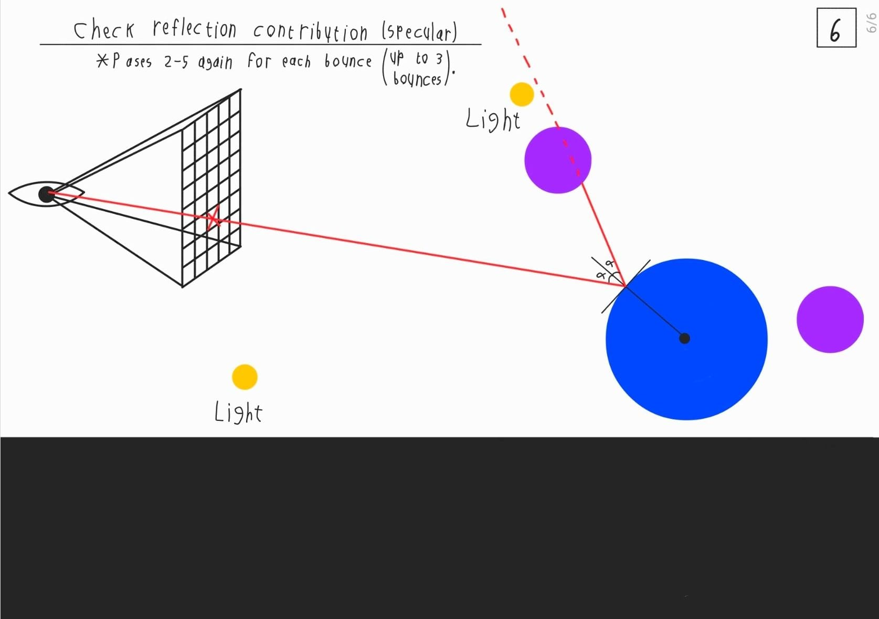

Slide 39
Repeat

Slide 40
Benchmark #2 - Raytrace
What is ray tracing?
Implementation Overview
Initial Analysis
Software Optimizations
Performance Comparison
Hardware Accelerator Proposal

Slide 41
Benchmark #2 - Raytrace
What is ray tracing?
Implementation Overview
Initial Analysis
Software Optimizations
Performance Comparison
Hardware Accelerator Proposal

Slide 42
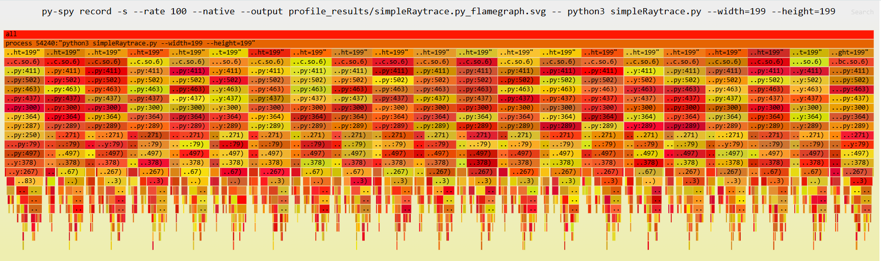
Flame graph
These are 20 “dripstones” where each is a run pyperf examined (as we know, pyperf performs multiple runs to analyze performance).
So we can’t really notice much in this frame.

Slide 43
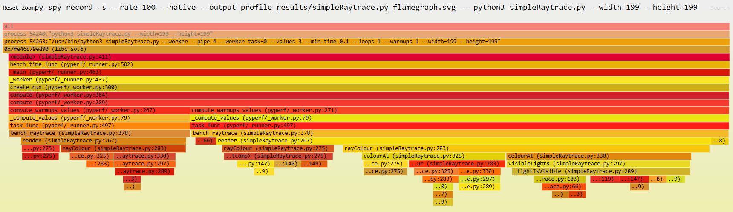
Flame graph - continue
Virtually everything is under render, and there’s a recursive function usage.
But we can notice that one computational function is taking more than others…

Slide 44
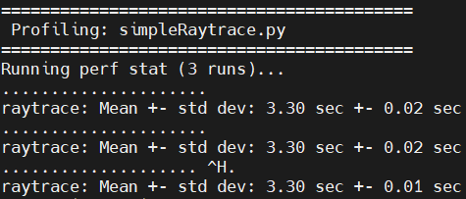
pyperf’s results
We have examined on images of size 199x199 and got:

Slide 45
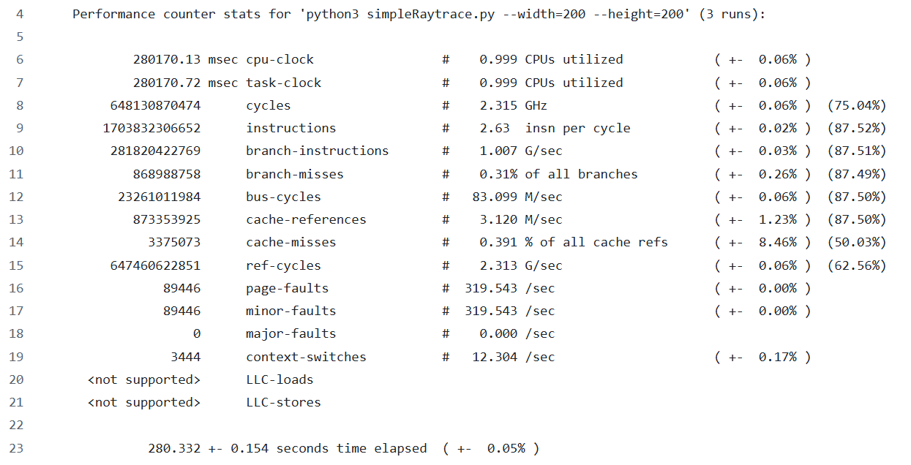
perf’s results
perf on the other hand, gave confusing results. Why? We will see later on.

Slide 46
perf’s results - continue
Stat | Original (Python)
pyperf time | 3.30 [s]
total time elapsed [seconds] | 276.8
cycles | 639 B
instructions | 1.68 T
branch instructions | 277 B
branch misses | 874 M ( 0.31% )
cache references | 868 M
cache misses | 2.5 M ( 0.292% )

Slide 47
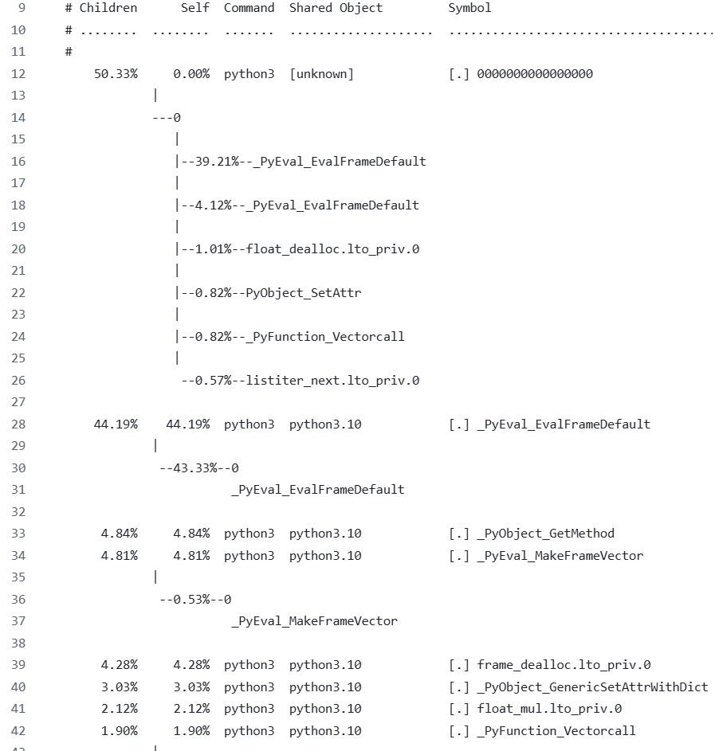
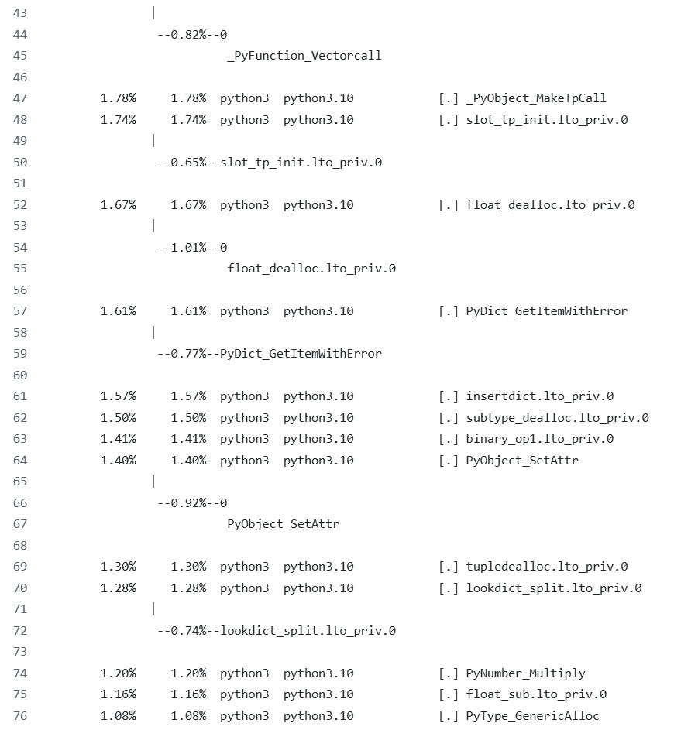
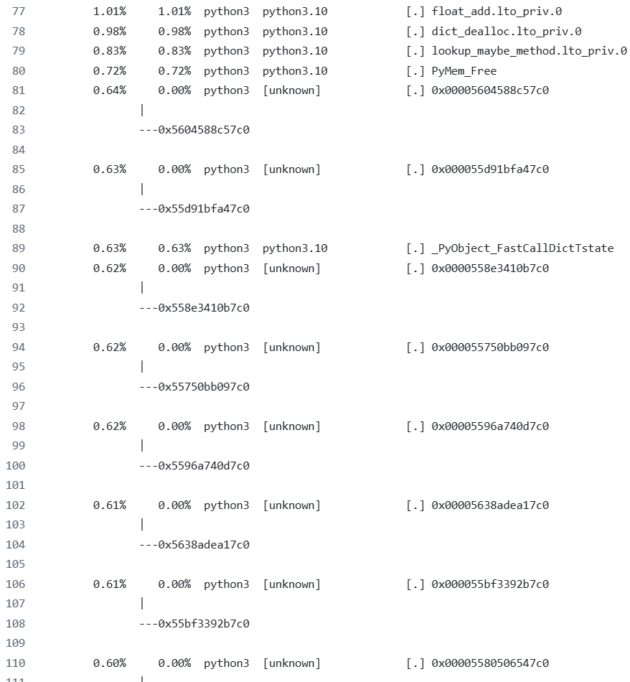
Python Functions call stack
Can you notice our computational functions? Me neither.

Slide 48
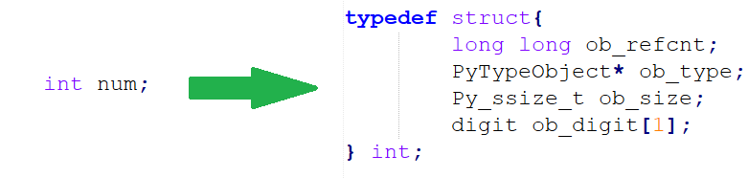
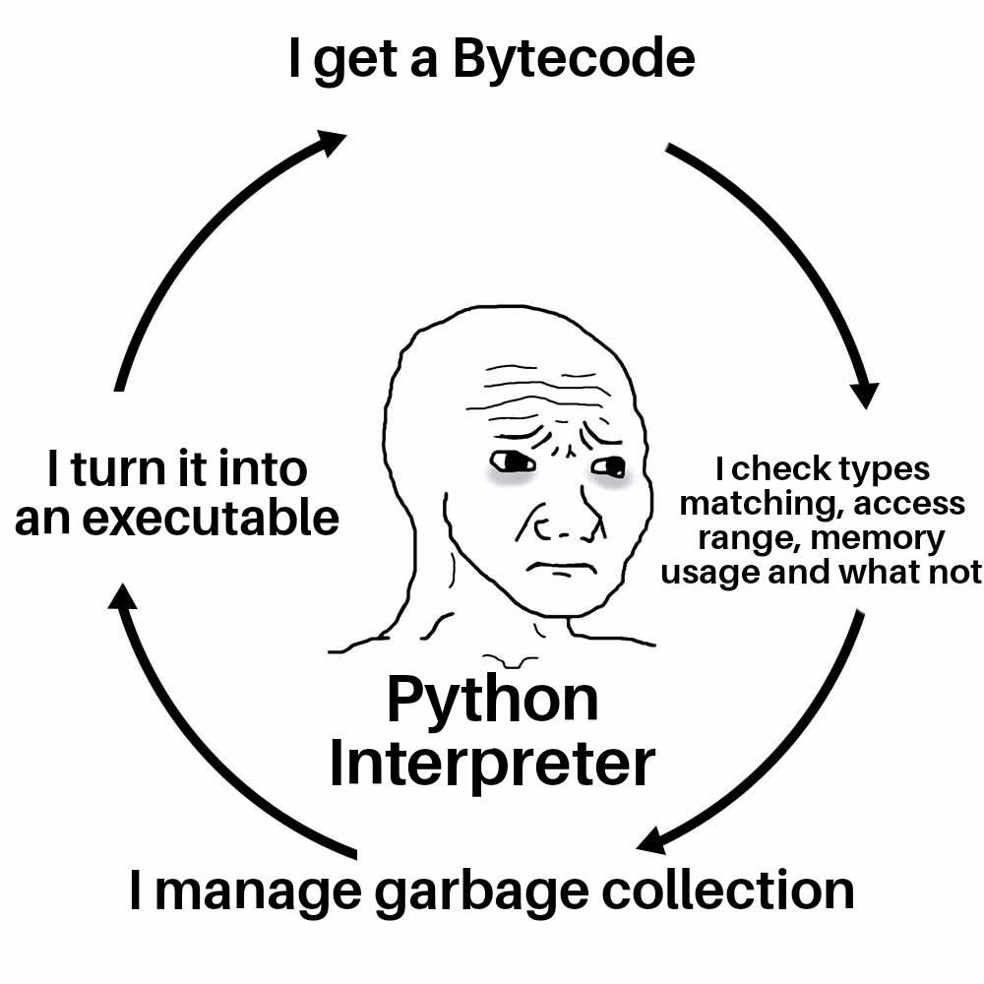
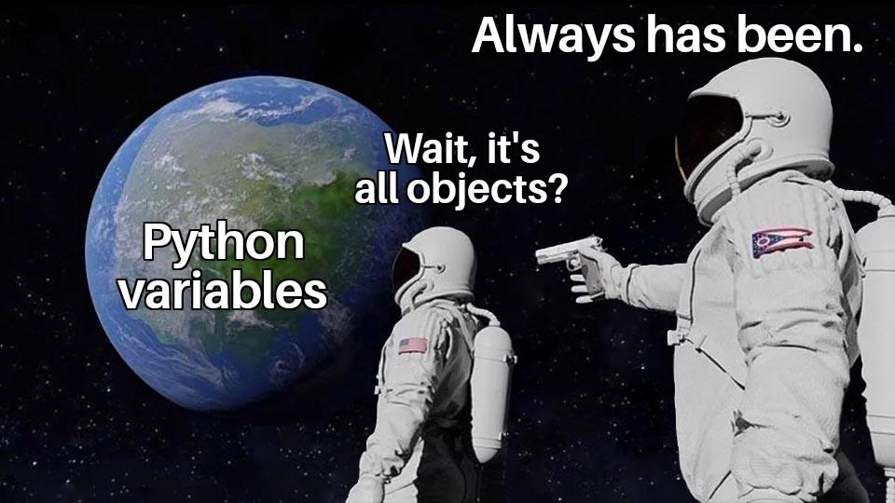
The Head of the Snake
That’s pretty much points toward the main bottleneck in our benchmark - Python itself.

Slide 49
Benchmark #2 - Raytrace
What is ray tracing?
Implementation Overview
Initial Analysis
Software Optimizations
Performance Comparison
Hardware Accelerator Proposal

Slide 50
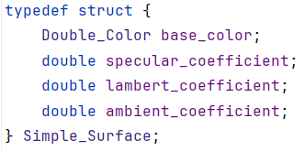
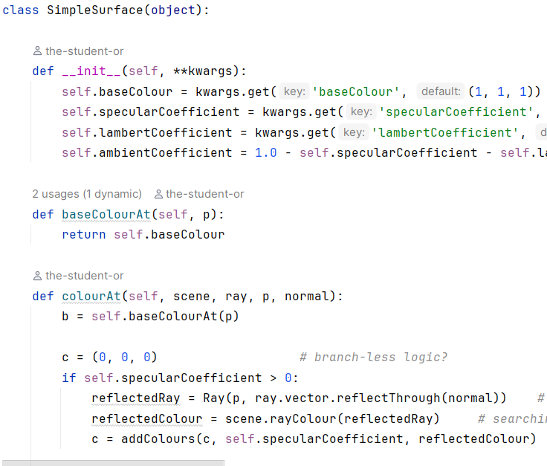
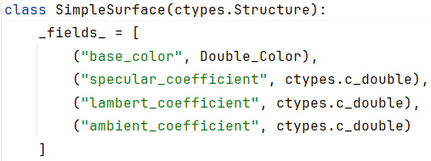
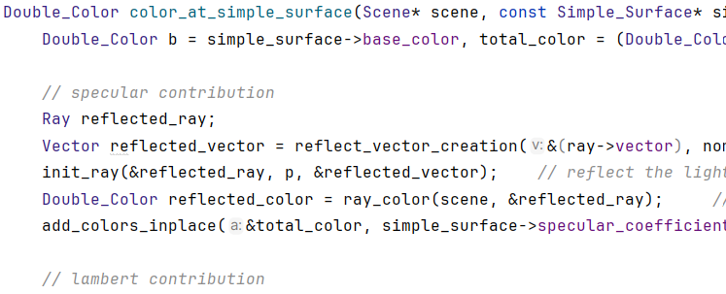
ctypes
We can get rid of that extra weight if we know what we are doing, but only if we manage the data correctly (and we can), implementing functionality in C.
A library that allows using a C code in Python with an interface.

Slide 51
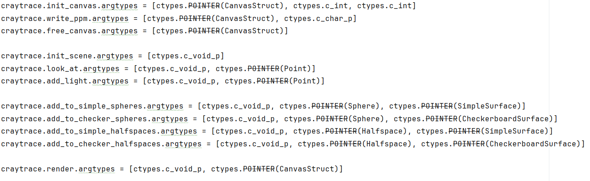
ctypes - continue
Part of the definition of the interface with Python, telling what each function that is used in Python (and not internally in C) and what input they get.

Slide 52
Benchmark #2 - Raytrace
What is ray tracing?
Implementation Overview
Initial Analysis
Software Optimizations
Performance Comparison
Hardware Accelerator Proposal

Slide 53
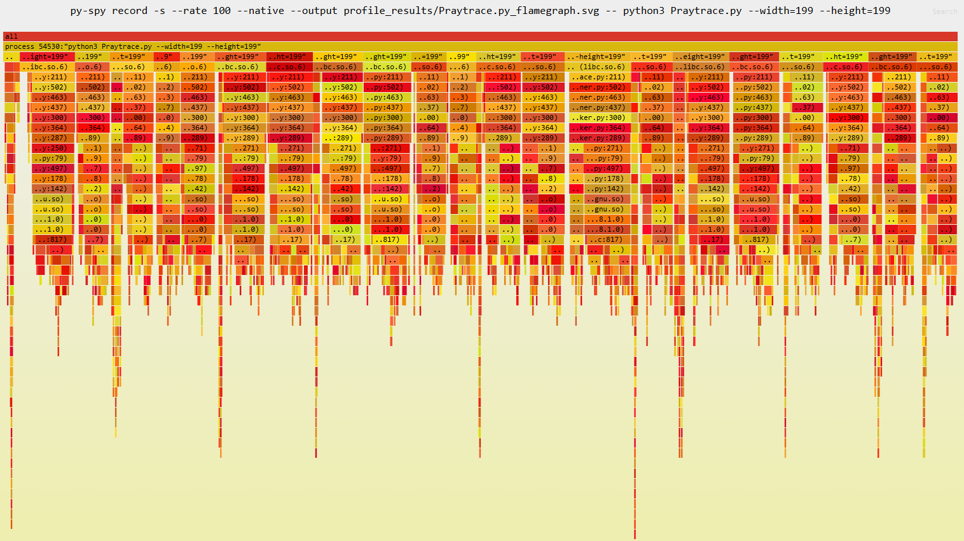
Flame graph
Again, there are 20 “dripstones”, so this frame didn’t tell us much.

Slide 54
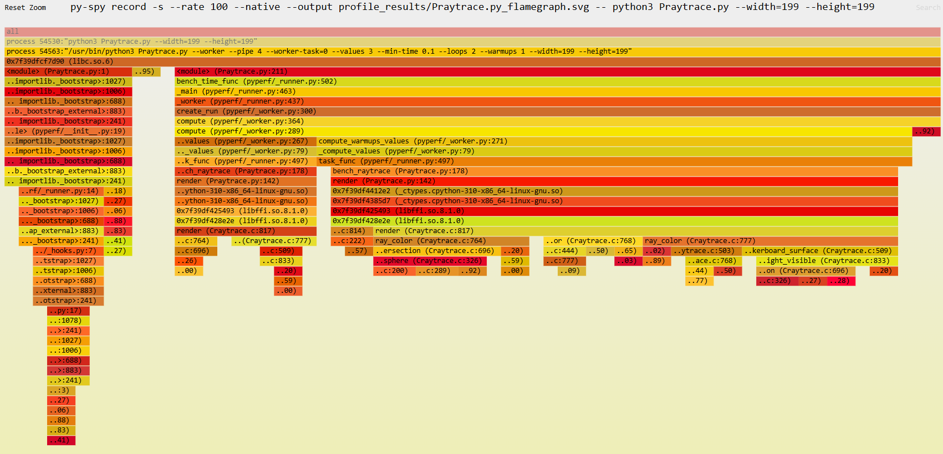
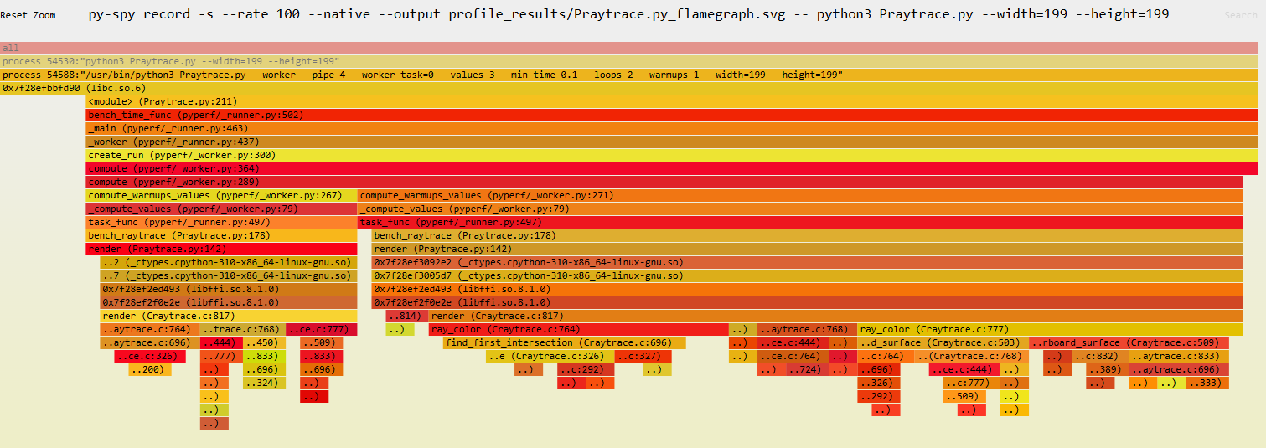
Flame graph - continue
There are two typical “dripstones”.
Left is when we caught only mostly the computations.
Right is when we caught the overhead of making an interface to a library that isn’t native to Python.
We once again see that the costlier function is the calculation of intersection time, for similar reasons as it was in the Python code.

Slide 55
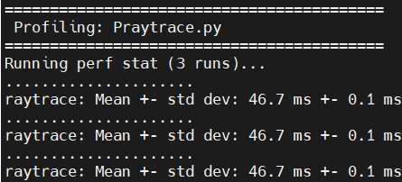
pyperf’s Results
We have examined on images of size 199x199 and got:
Which is 70.6x faster than Python (3.30 seconds).

Slide 56
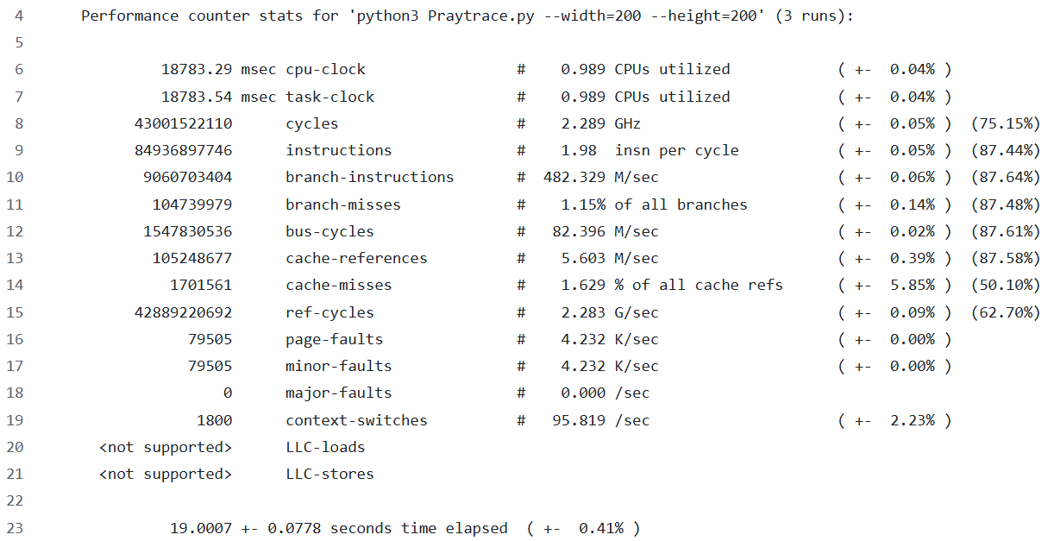
perf’s results
Original
(Python)
Optimized
(C)

Slide 57
perf’s Results - continue
Stat | Original (Python) | Optimized (C) | Improvement
pyperf time | 3.30 [s] | 46.7 [ms] | 70.6x
total time elapsed [seconds] | 276.8 | 19.06 | 14.5x
cycles | 639 B | 42.5 B | 15x
instructions | 1.68 T | 83.9 B | 20x
branch instructions | 277 B | 8.97 B | 30.8x
branch misses | 874 M ( 0.31% ) | 104 M ( 1.16% ) | 8.4x ( 0.267x )
cache references | 868 M | 111 M | 7.8x
cache misses | 2.5 M ( 0.292% ) | 1.5 M ( 1.42% ) | 1.67x ( 0.205x )
So much less instructions, but suddenly the speed-up is only 15x?
Is something wrong here? Could there be something that “corrupts” our data here?

Slide 58
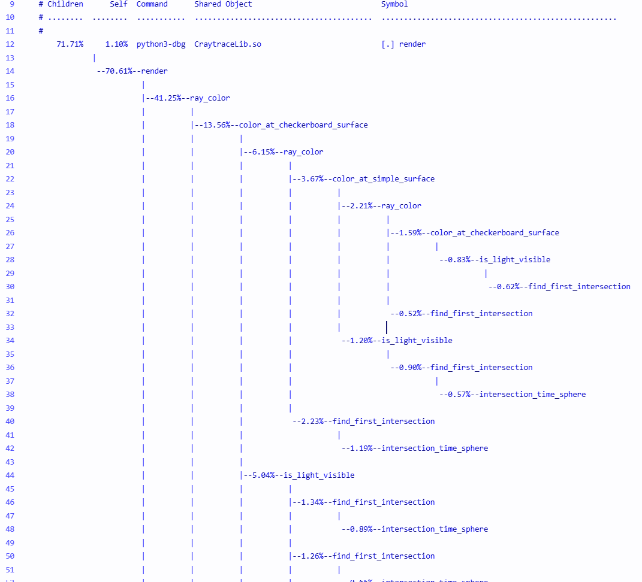
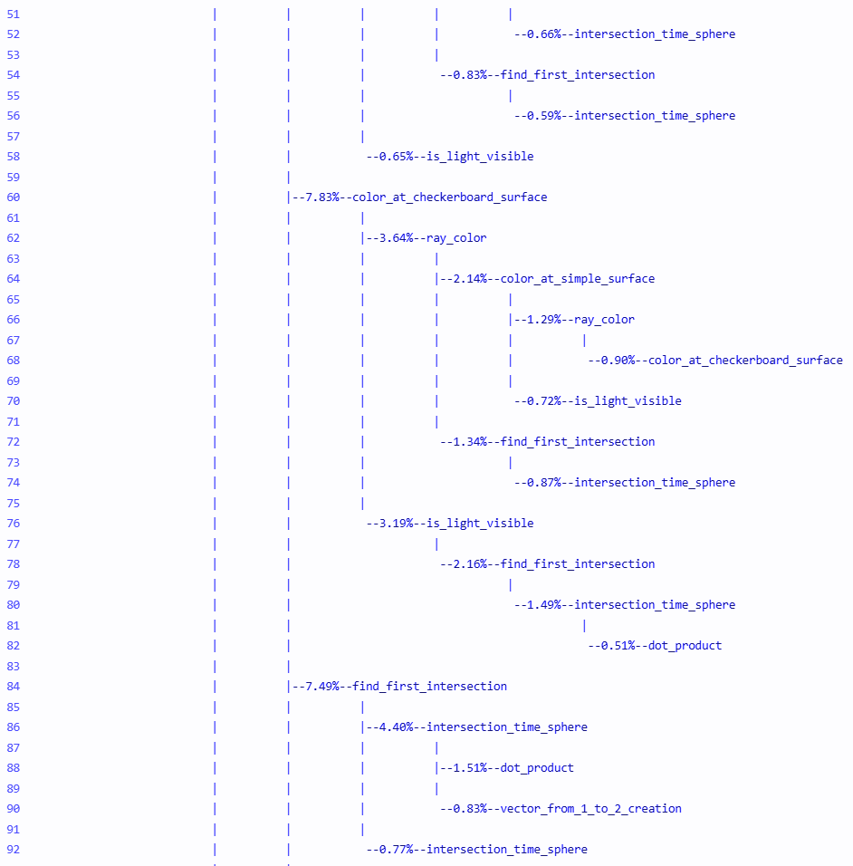
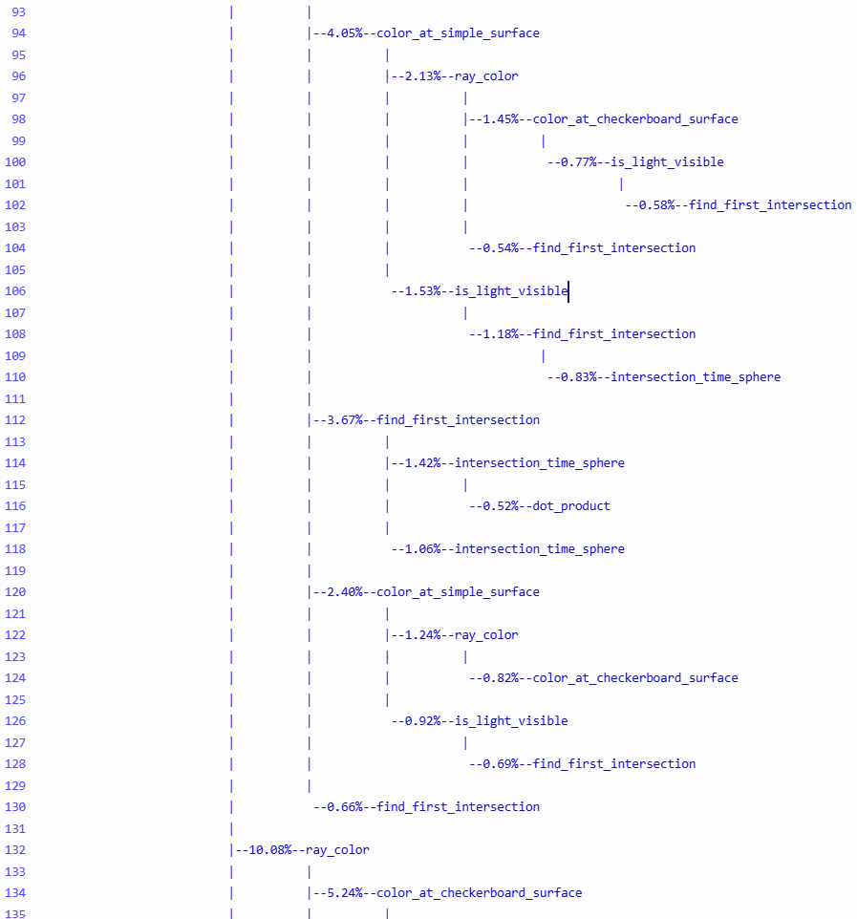
Python Functions call stack
Let’s check again the functions call stack again:

Slide 59
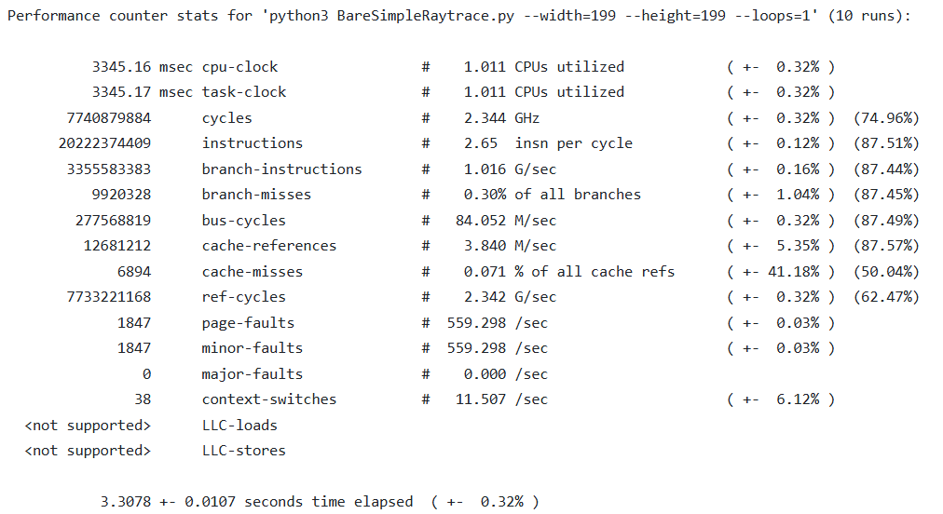
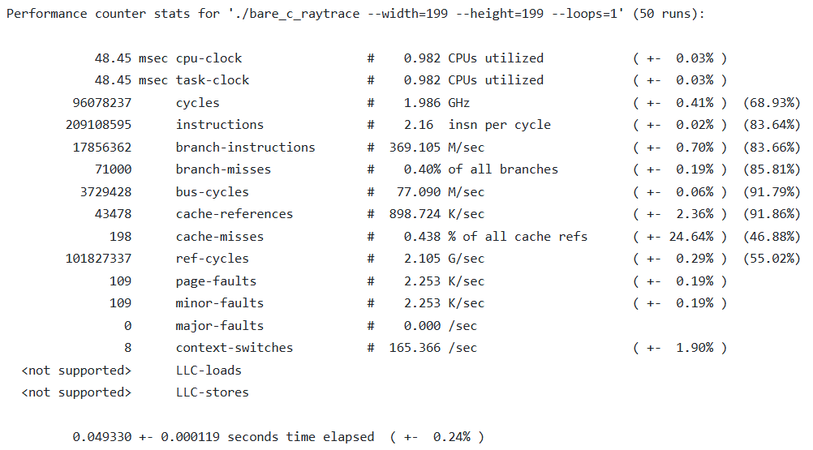
“Bare Metal”
Both programs run inside pyperf’s wrapper which is supposed to monitor, but it’s not an ideal profiler, it has its weight.
So to make verify this assumption, we made a “naked” version of the code (without pyperf).
Python
C

Slide 60
“Bare Metal” - continue
Stat | Original (Python) | Optimized (C) | Improvement
total time elapsed [seconds] | 3.307 | 0.0493 | 67x
cycles | 7.74 B | 96 M | 80x
instructions | 20.2 B | 209 M | 96x
branch instructions | 3.3 B | 17.8 M | 185x
branch misses | 9.9 M ( 0.3% ) | 71 k ( 0.4% ) | 139x
cache references | 12.7 M | 43.4 k | 292x
cache misses | 6894 invalid for 41% error | 198 invalid for 24% error | invalid
So pyperf’s reports earlier were correct, and it’s not like perf wronged us, it just can’t tell what is important for us and what’s not.

Slide 61
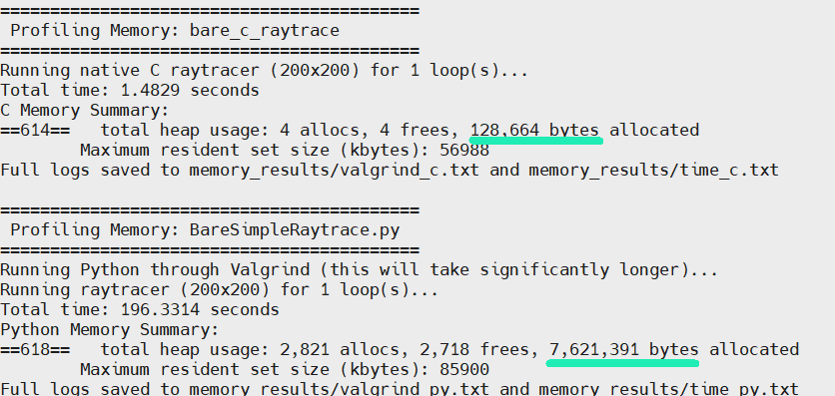
“Bare Metal” - continue
We also used valgrind to compare memory usage (as we said before, Python consumes more memory then C, let’s show it) (this time on 200x200 images):

Slide 62
Benchmark #2 - Raytrace
What is ray tracing?
Implementation Overview
Initial Analysis
Software Optimizations
Performance Comparison
Hardware Accelerator Proposal

Slide 63
Accelerator Justification
As we have saw at the Flame graphs and said before, the most expensive function is the find_first_intersection function, which gets a point and a ray and checks which object is its first intersection, and also returns the point at the object it intersects.
For a sphere, the intersection time requires 4 additions, 6 subtractions, 8 multiplications and 1 root.
For a halfspace, the intersection time requires 2 additions, 3 multiplications and 1 division.
Repeat for all objects every time we search for an intersection(!).

Slide 64
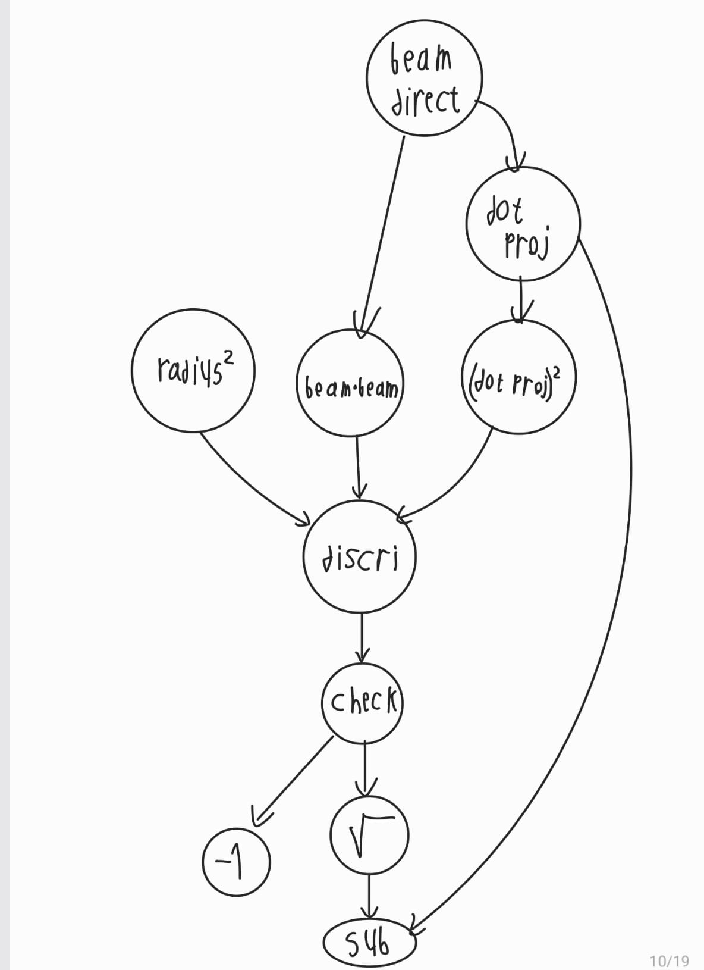
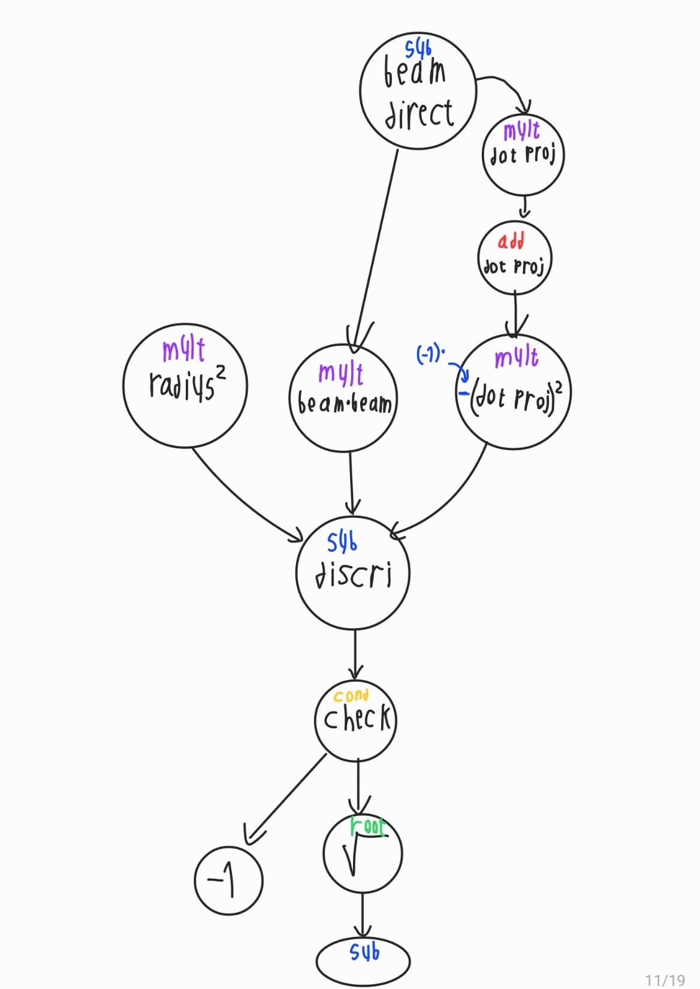
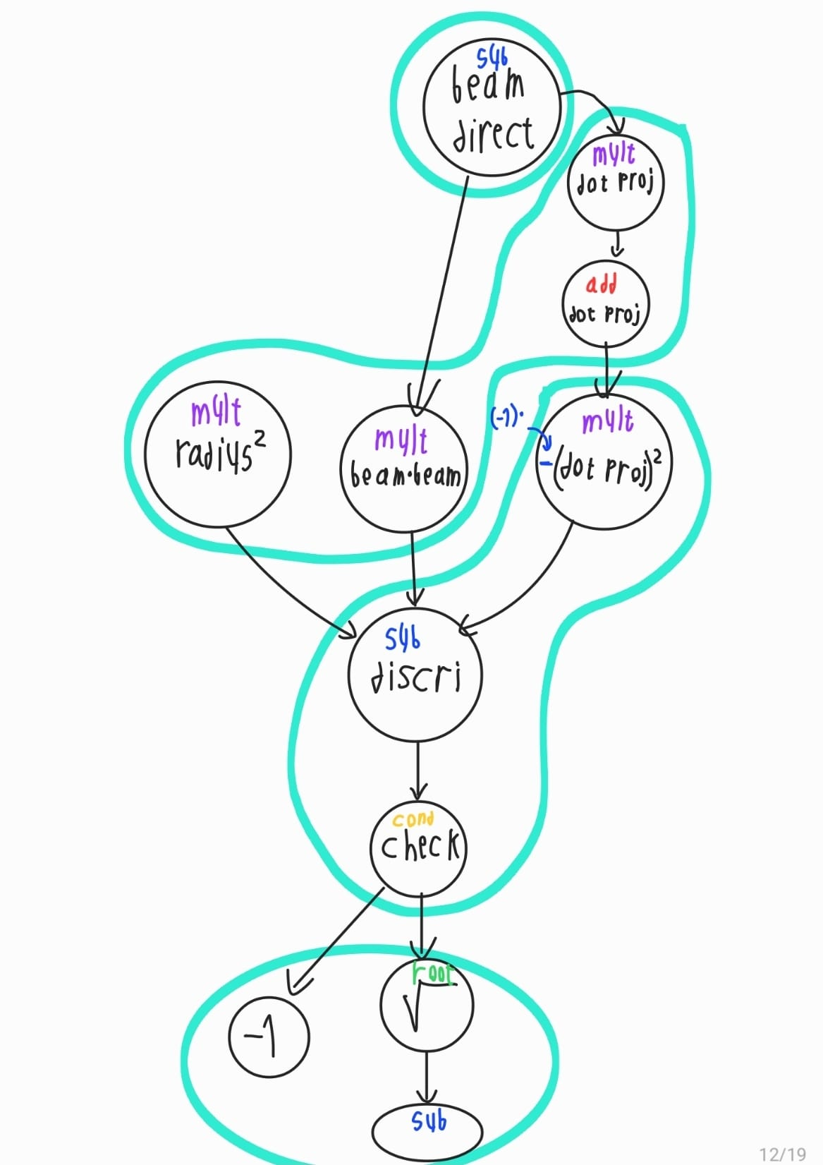
Hardware Architecture
We notice that floating-point is harder to deal with than with fixed-point.
64 bits take longer to process than 32 bits.
Some calculations are independent and can be done at the same time, but the CPU doesn’t have the capacity to do them.

Slide 65
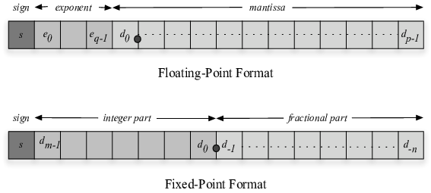
Hardware/Software Interface
64 bits -> 32 bits.
float / double -> fixed-point.

Slide 66
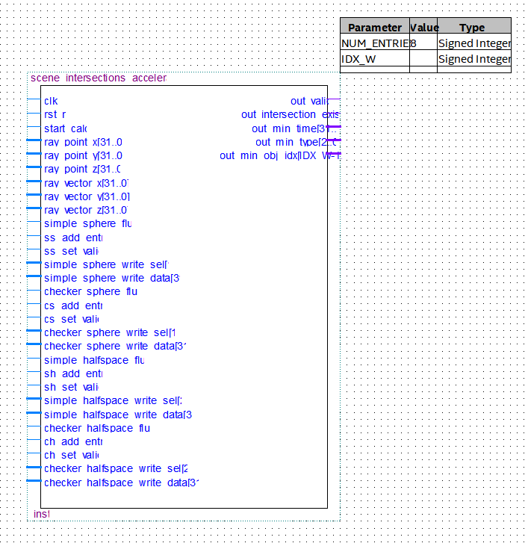
Inputs / Outputs
The ray is the most important one, it changes orders of magnitude more frequently than any other data input.

Slide 67
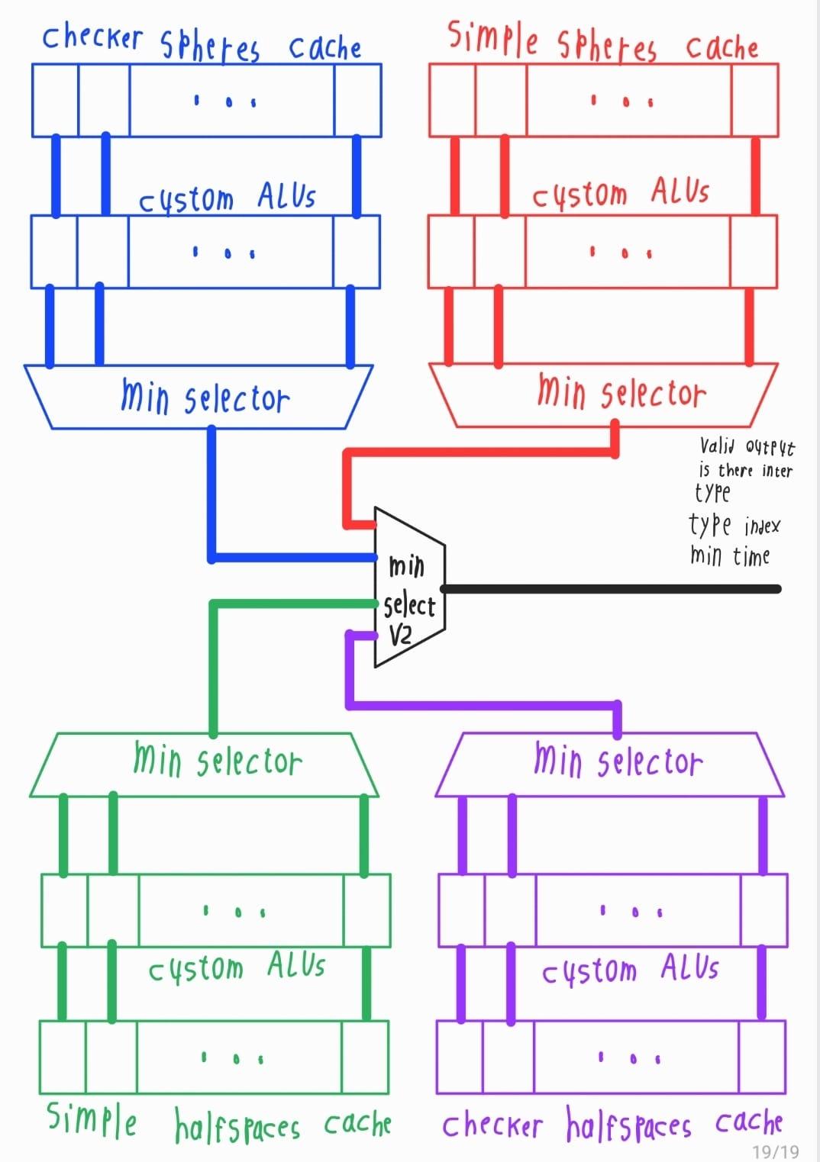
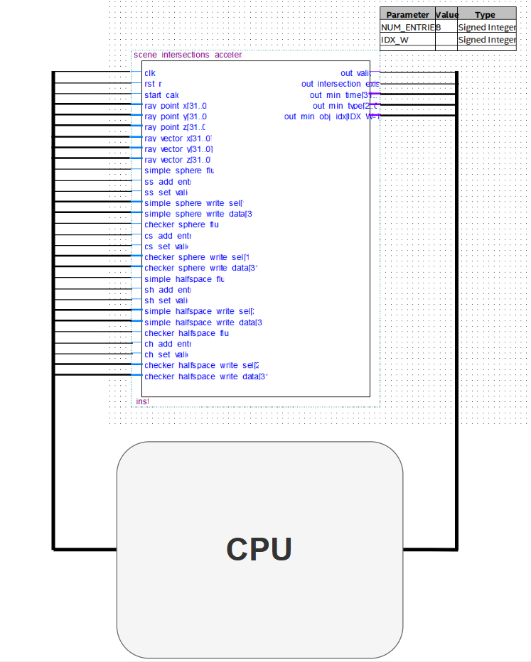
Blocks Diagram

Slide 68



Trade-Offs
floating point VS fixed-point
serial VS parallel ASIC

Slide 69
PPA Trade-Offs
Attribute | Original | Custom
Accuracy | 64 bits float, has an accuracy of up to 2⁻⁵² ~ 2.22*10⁻¹⁶. Dynamic, maximal scale of 1.79*10³⁰⁸. | ~1.56*10⁻⁵ due to fixed-point on a smaller data representation (32 bits). Constant, maximal scale of 65,536.
Performance (speed) | Serial. Has to take care of changing float values. | Parallel, taken a function that took most of the run and made it 1.31x faster. By Amdahl's law it’s faster.
Power | Baseline | Much larger as, has more circuitry, each with a clock and are active (desirably and virtually) for the entire run, possibly larger than the CPU itself (the necessary cooling is insane ): ).
Area | Baseline | Much larger due to addition of wires for data transfer and the accelerator’s circuitry.

Slide 70

The Road Not Taken
Software threads.
Another device (DMA).
Complete functionality.

Slide 71


